Slide 1


Cosmic force productivity from ray
Supported by
M.Rajapartheban
Assistant Professor/
Research Incharge
Presented
by
a.abarna
k.durgadevi
ECE Student
Mailam engineering college
Department of Electronics and communication Engineering
In my own World

Slide 2
ABSTRACT
Solar Energy is a renewable energy and it radiant energy that is produced by sun every day the sun radiates or sends out and enormous amount of energy .solar panels are designed to absorb the sun rays as a source of energy for generating electricity.
Mono crystalline and polycrystalline solar panels are commonly used to produce solar energy. Monocrystalline are most efficient type of photo voltaic cell (14-19%).but it is most expensive due to their high silicon content , ideal or smaller surface area. In Polycrystalline a large block with a bunch of irregular multi crystal its efficiency is (13-17%) because the use of lower silicon levels.it is less expensive it has high cost.
In order to improve the efficiency of existing solar panel , we are using “Solar panel with BLUE RAY DISC” which has efficiency of 21.8% more than the existing solar panels.

Slide 3
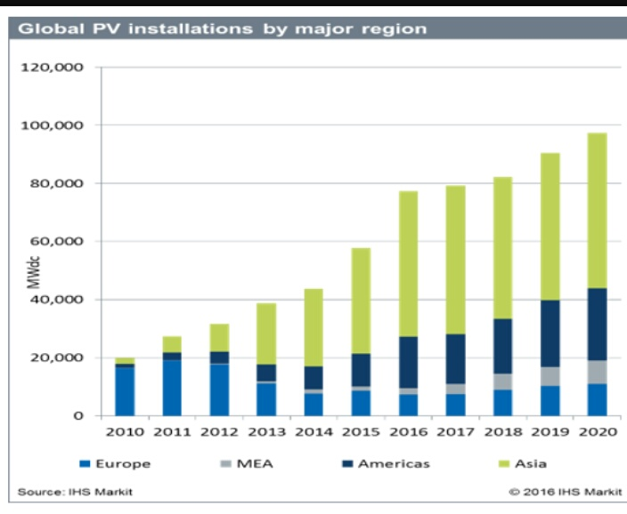
PV INSTALLATIONS

Slide 4
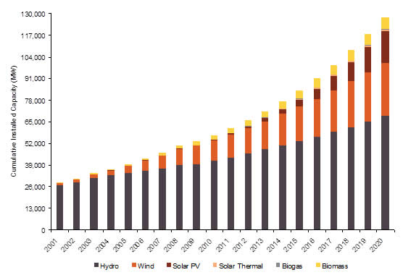
RENEWABLE RESOURCES

Slide 5
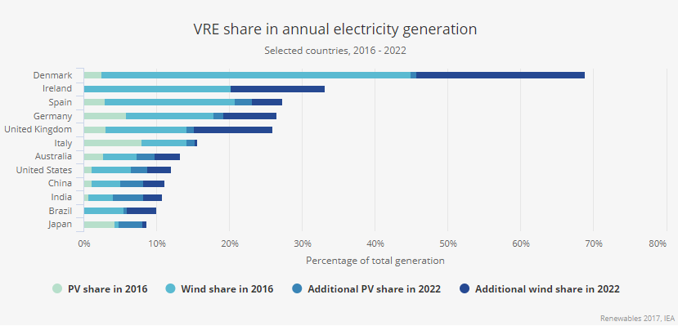
ENERGY PRODUCTION

Slide 6
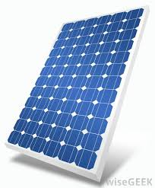
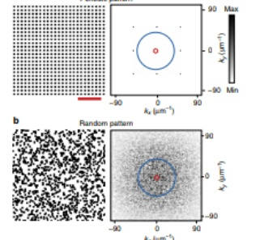
PROBLEM STATEMENT
The Photons which strike the solar panels get scattered away instead of converting into electrons to generate current leads to low efficiency.
REASON FOR LOW EFFICIENCY:
Already existing pattern
1.Orderly pattern-concentrate only one wavelength.
2.Random pattern-wavelength seen in sunlight

Slide 7
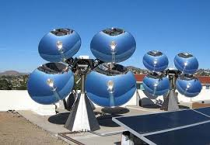
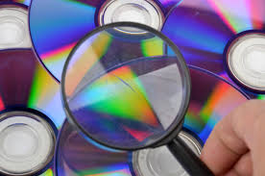
PROPOSED SOLUTIONS
"According to new research from a team at North western University, Illinois, it has been discovered that the scattering effect on light shone through the arrangement of data etched on a Blu-ray disc improves energy absorption across the spectrum of light used by solar cells..
The overall broadband absorption enhancement of a Blu-ray patterned solar cell was measured to be 21.8 percent, the researchers report.

Slide 8
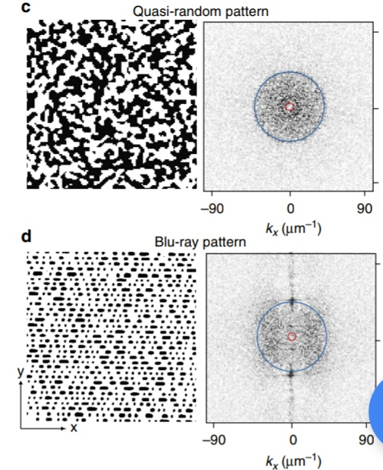
WHICH IS THE BEST PATTERN?
QUASI PATTERN-Expensive in fabrication
-But abundant in nature
-Structural coloration in bird
-And in blue ray disk

Slide 9
Blu- ray disk
Blue ray disc is a digital optical storage disc.
Capable of storing several hours of video with high resolution.
Associate Professor Jiaxing Huang, at North western, working with Associate Professor at McCormick, Cheng Sun, tested on different Blue-ray discs. However, no matter the content, the patterns of these all performed alike in improving solar cell light.
Quasi-random pattern.
Blu-ray pattern was around 21.8 percent much greater than a standard solar cell absorption.

Slide 10
HOW TO MAKE QUASI RANDOM PATTERN
Audio and video compression
Audio and video compression
Audio and video compression
Audio and video compression

Slide 11
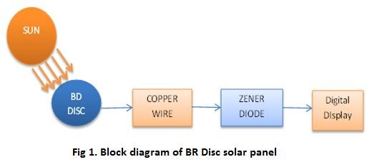
PROTOTYPE OF OUR CONCEPT
Types | Voltage
C. D. | 12 mv
D. V.D. | 35 mv
BR Disc | 1.0 v
Solar cell | 5.8 v
BR platted solar cell | 6.4 v

Slide 12
FABRICATION OF BLE RAY DISC ON SOLAR CELLS
Uncover and expose pattern of disc(PDMS)
Imprint these pattern on active layer
Leading to high absorption
High power conversion efficiences

Slide 13
Measuring PV Efficiency
Efficiency in photovoltaic solar panels is measured by the ability of a panel to convert sunlight into usable energy for human consumption.
The panel efficiency determines the power output of a panel per unit of area. The maximum efficiency of a solar photovoltaic cell is given by the following equation:

Slide 14
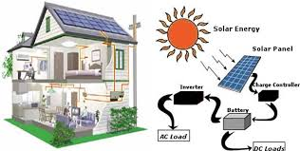
Blu-ray disc ENERGY SYSTEM
Blu-raydisc panel

Slide 15
advantages
Efficiency is high.
Blue ray disc is more advantage than DVD.
Blue ray patterns work with other common types of solar cells.
Low cost consumer product.

Slide 16
conculsion
Our proposed solution ,BLUE RAY DISC on solar panel increases the efficiency compare to normal solar panels.
Thus we can save our world by increasing the energy resources for our future generation.

Slide 17
Thank you

